Slide 1

TWO – Minutes: Know your Trainer
My name is Kumar Vikas.
Working as a Senior Cloud Architect for one of the BIG4s.
Have 12 years of overall IT experience with expertise in Various cloud technologies, Dev ops, Python, etc.
Worked with AWS & Devops for many years now: Built websites, online gaming apps, data-engineering, migration of various enterprises.
Passionate about teaching and sharing my knowledge with you, which I gathered HARD-WAY !!!!
Notes:
Learning is not a race take your time but set a goal .
To begin with things may look scary but trust me you are at right place with right trainer .I will put effort to keep it simple ,Informative and interactive .
It’s a very hands-on course which keeps you involved and different from any other instructor .
The way I teach is , I will explain everything via diagrams .In this incremental learning process you start at very basic level ,learn new skills , use those skills and reuse them .
You end up with great confidence and industry equivalent experience .

Slide 2
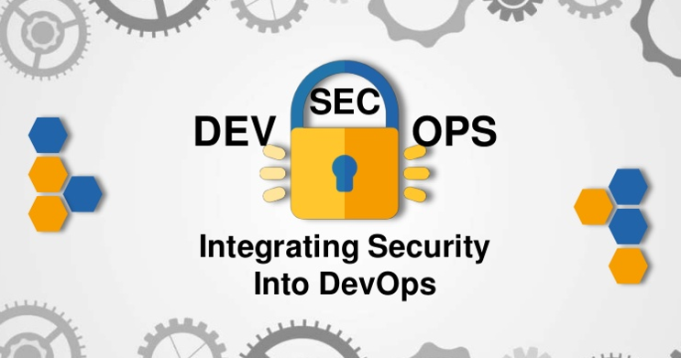
Introduction to DevSecOps & AWS
The Era has changed
Vikas
Notes:
Hello and welcome all. Happy to see you here. In this course you will learn all concepts you need to become a DevOps engineer on the cloud in a hands-on oriented manner. You understand your task and responsibility. You will be able to understand and will be able to deliver end-to-end projects on the enterprise level smoothly.
You learn automation and the various process involved in the DevOps world. This makes you extremely valuable to your current as well as future organization.

Slide 3
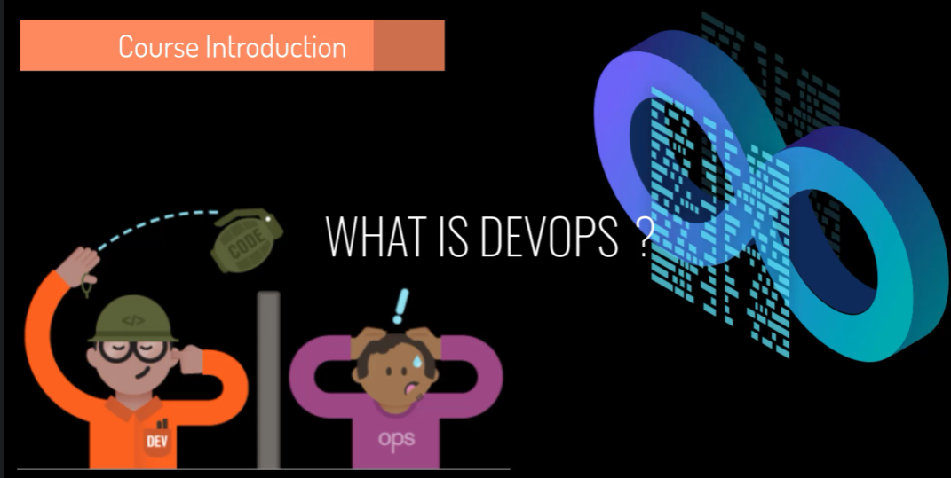
Notes:
This complete course is outcome of my struggle while implementing and understanding when I first started of . So, I bring everything together here .
Trust the trainer .
This is my optimal way of teaching you about specific topics .Trust my teaching process you will enjoy the learning and reap benefits of hard work .
Prepare yourself for a real cloud-devops job .
=============================
Get solid foundation by understanding the concepts .
Intense handful experience .
Learn by getting your hands dirty .

Slide 4
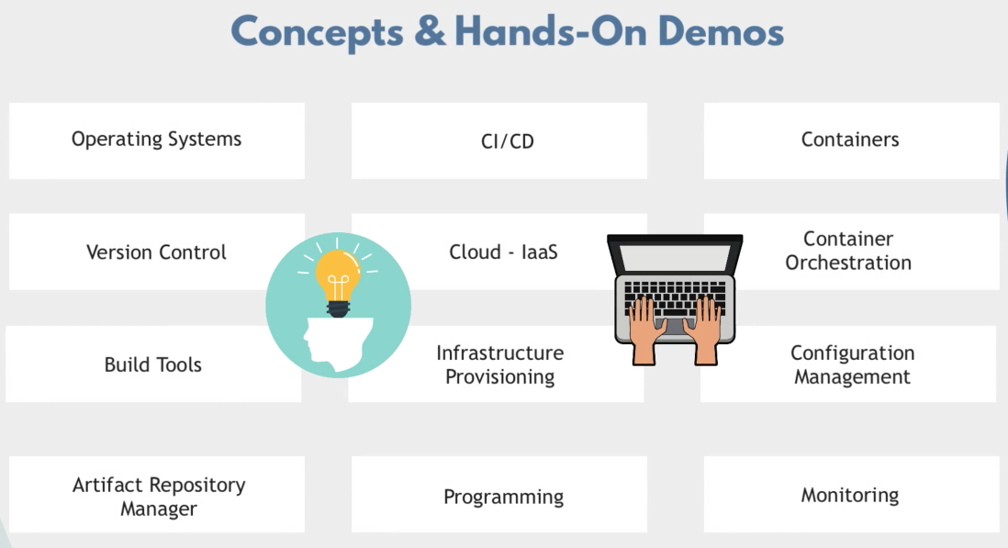

Slide 5
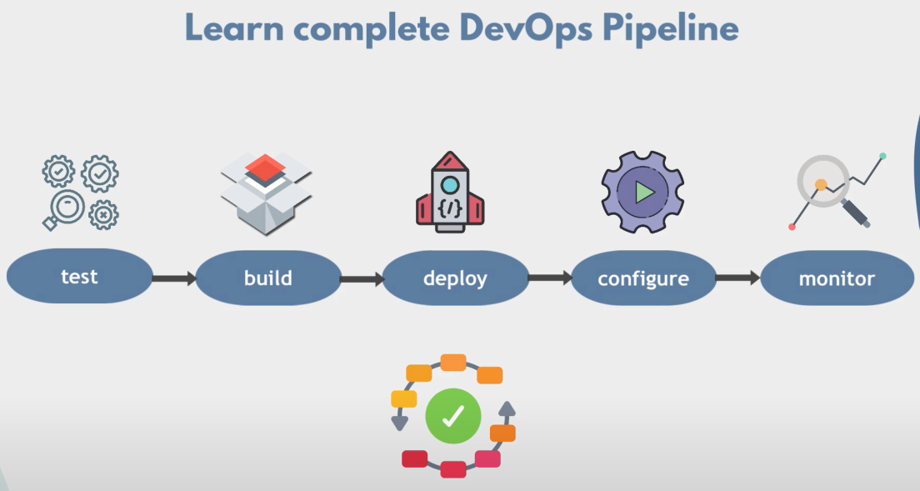

Slide 6
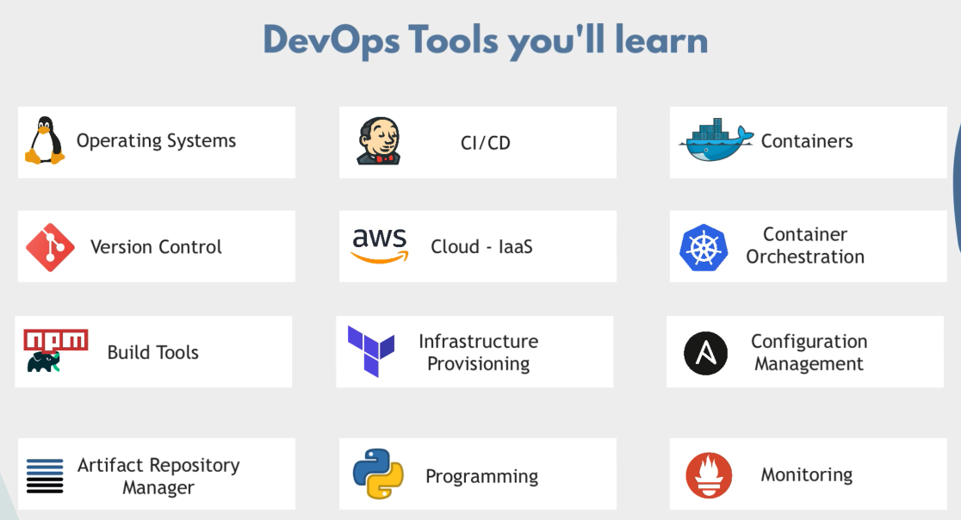
Notes:
We prepare you for real Cloud - DevOps jobs by a solid understanding of the concepts and intense hands-on practical sessions.
Exercise
Communication
Learn by getting your hands dirty
Half knowledge is dangerous

Slide 7
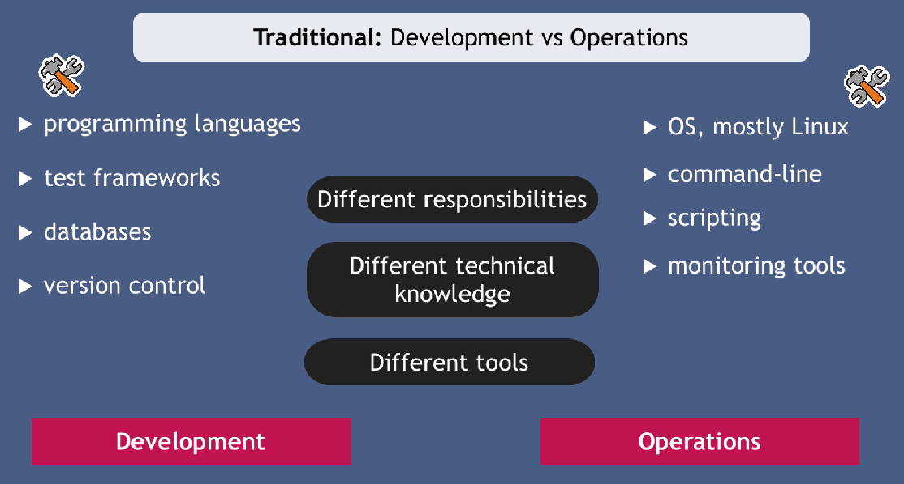

Slide 8



Slide 9
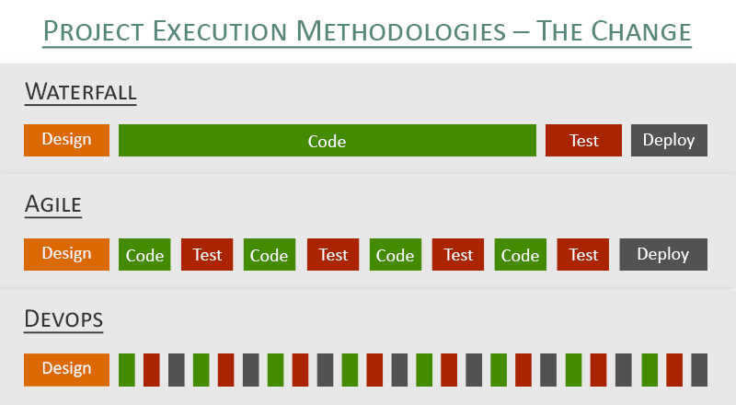
Notes:
Agile mostly focuses on SDLC whereas Devops talks about automation and continuous improvement.

Slide 10
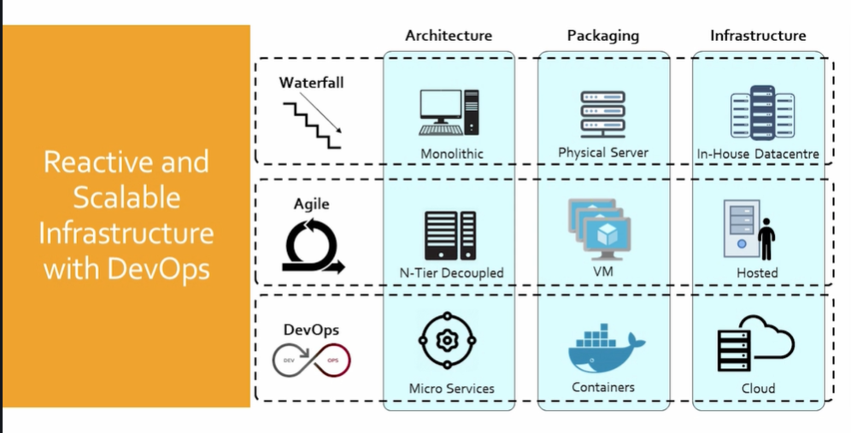
Notes:
Agile mostly focuses on SDLC whereas Devops talks about automation and continuous improvement.

Slide 11
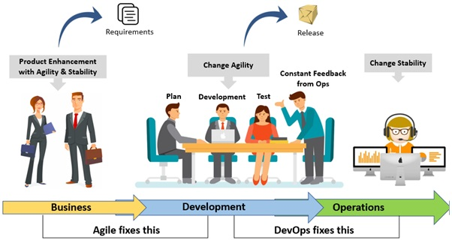
Notes:
Devops compliment agile:
------------------------
1. Teams have different mindset:
Customer - Business
Business Owner - Revenue
Dev Team - well structured and functioning code.
Ops Team - Stable and secure Infra
Boss - time to market & secure and stable servers from frequent releases.
2. Release and deployment mismatch
3. unpredictable issues.
4. Blame game.
5. Lack of monitoring and feedback.

Slide 12
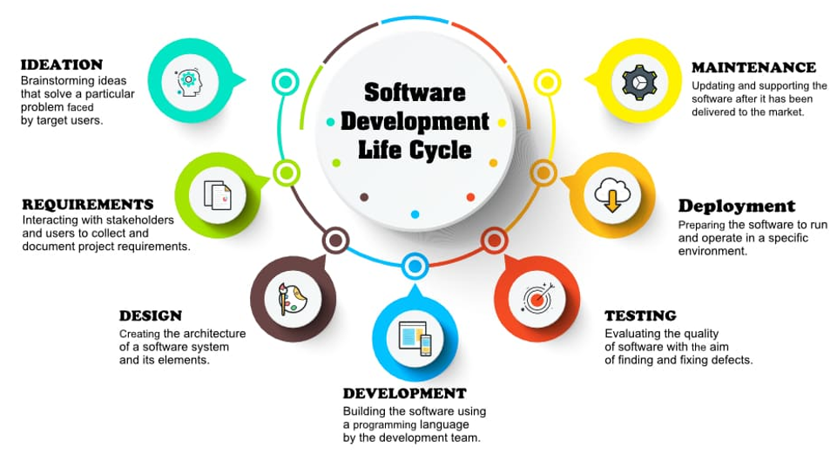
Notes:
Organization Requirements:
-------------------------------
1. Reliable and high-quality product which can be frequently upgraded.
2. Software delivery with premium quality.
3. Smooth development and quick feedback mechanism .
Problems faced by Product Development Team :
--------------------------------------------
1. As the development progresses managing, and tracking change becomes difficult.
2. Incremental builds are difficult to test and deploy.
3. Manual testing is time consuming and lacks quality.
4. Environment consistency ,adaptability and scalability is never tested, which leads to environment related issues .

Slide 13
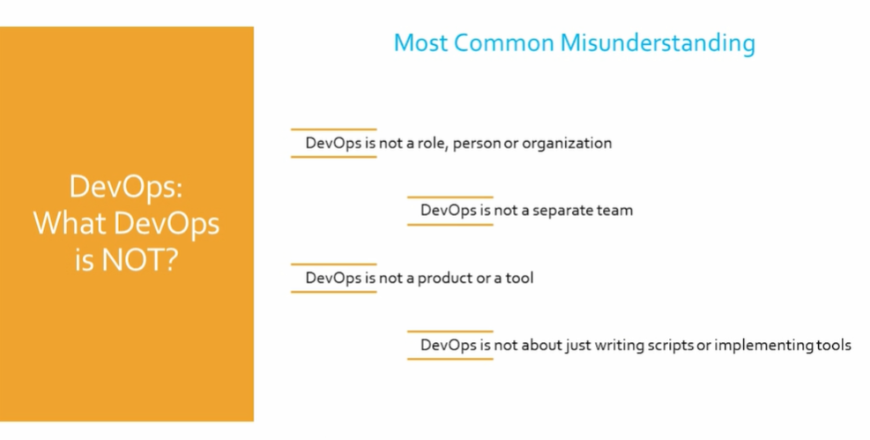

Slide 14
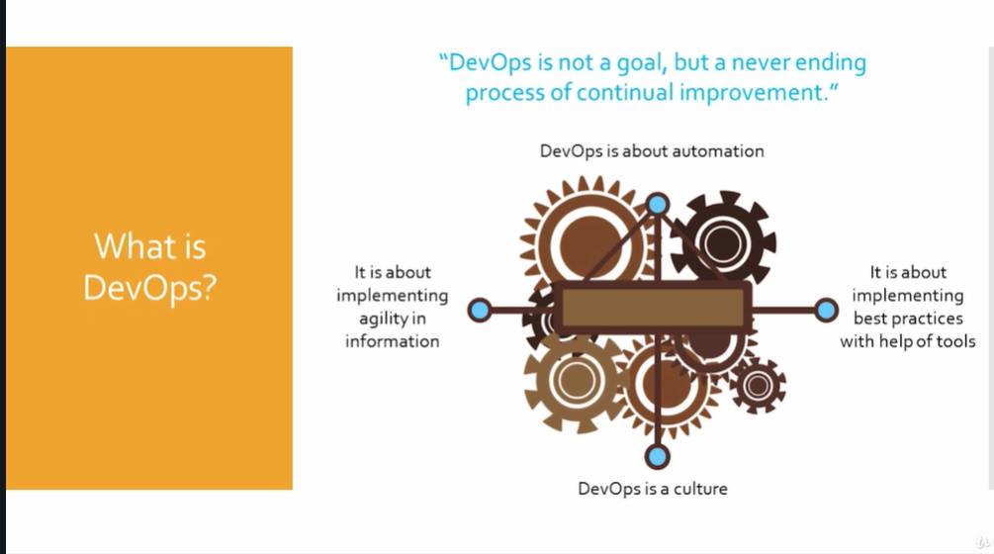
Notes:
Devops is a Software Development methodology which improves the collaboration between developer , Operation ,Network ,Testing & Operations teams using various automation tools which are implemented on various stages of Devops lifecycle .
Improve collaboration
Continuously measure application efficiency
Automate workflow and infrastructure
It’s a cultural ,process and technology transformation
Adopt tools and automate every task .

Slide 15
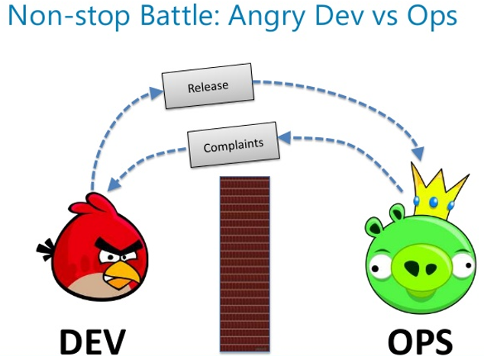
Notes:
Developer – Developer + QA Engineer + Release Manager + Build Engineer + Support Engineers + Program Managers .
Operation – Sys Admins + Network Admin + Middleware Admin + Storage Deployment + Deployment Admin

Slide 16
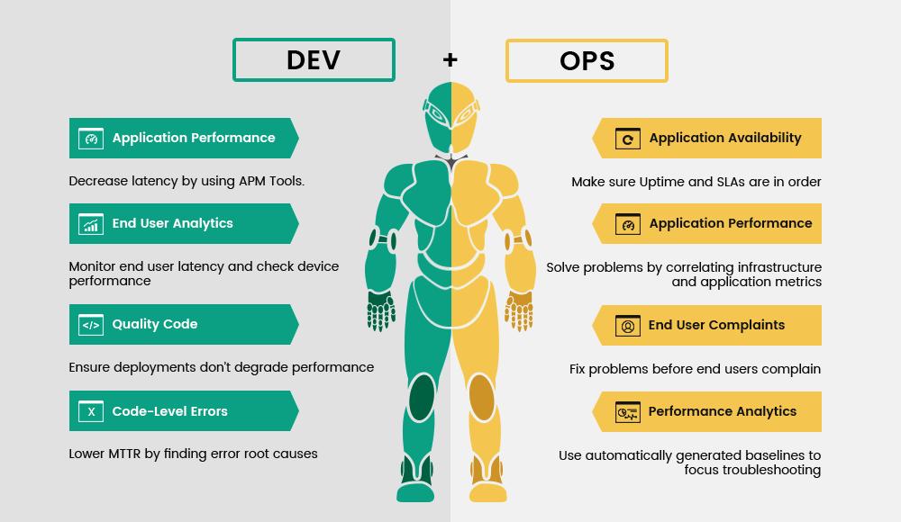

Slide 17
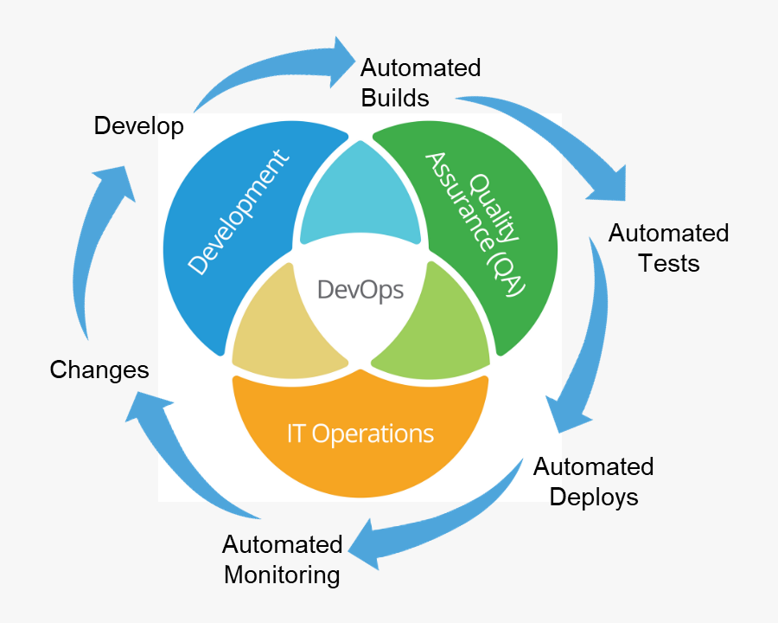
Notes:
Dev ops is a culture , a philosophy where Developer and Operation team can collaborate and participate together in agile practice through entire software lifecycle ,from development to production support .
Devops is not learning fancy tools .It’s about people solving problems together .
Automation and continuous integration .
Collaboration and communication
Devops is beyond few tools & CICD. Different problems can be solved in multiple ways, and we take the best practice present in Industry and provide solution based on the scenario.

Slide 18
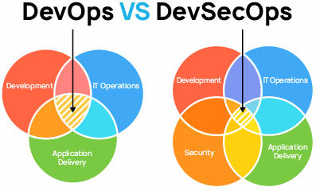

Slide 19
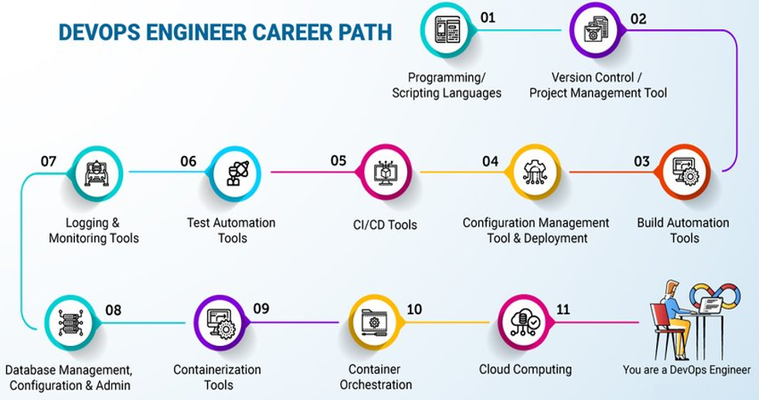
Notes:
Cross-Skills training
Add new skills
Automate task
Community Involvement

Slide 20
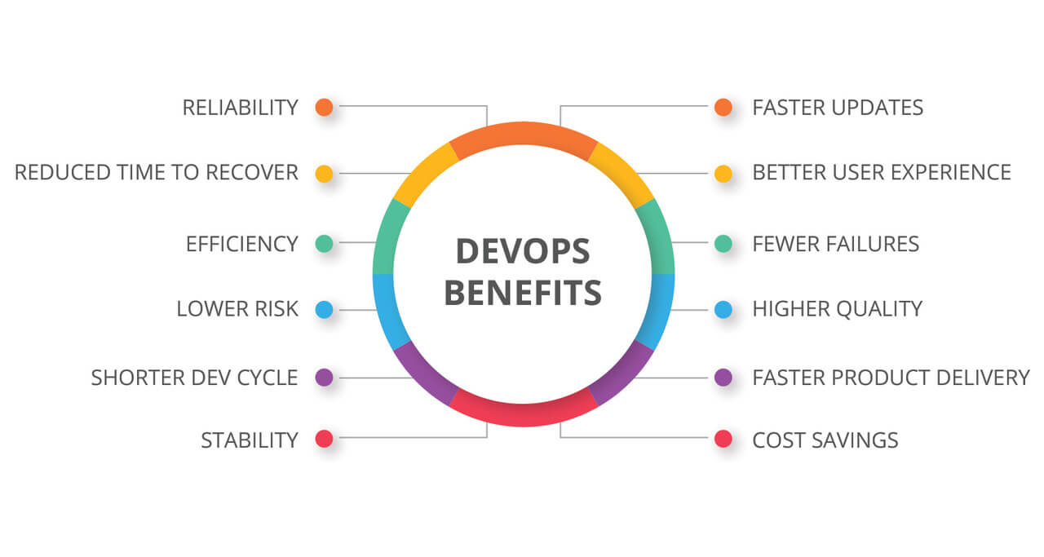

Slide 21
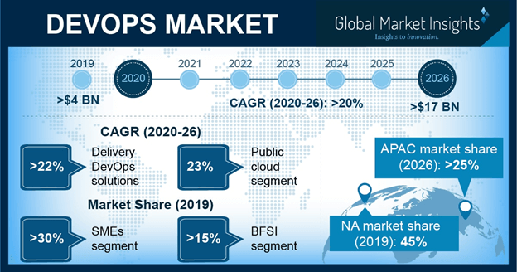
Notes:
Considering the changing pace of IT landscape , almost all the companies require fast paced development environment.

Slide 22
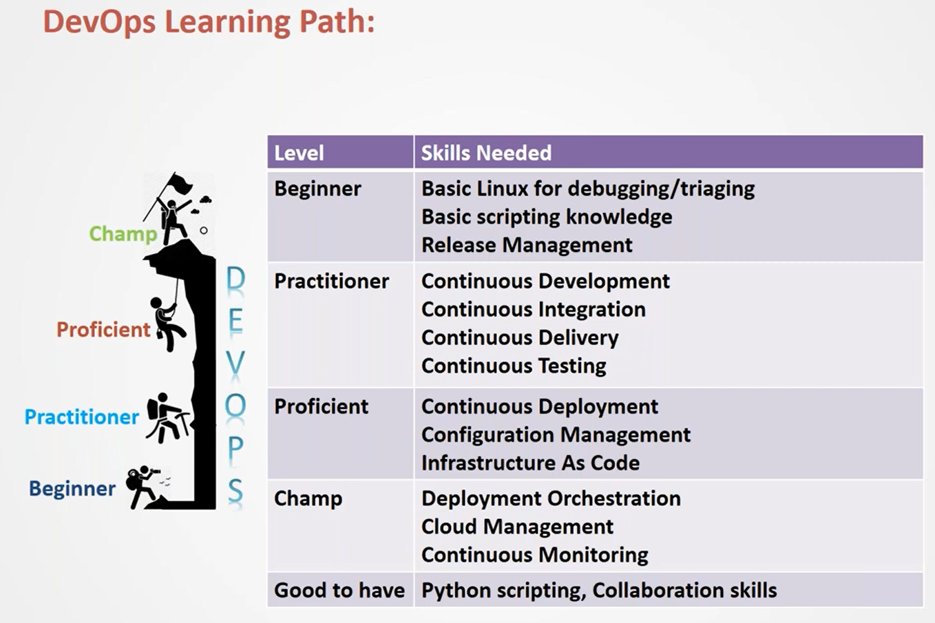
Notes:
Terminology :
Continuous Development/Delivery
Continuous Integration
Continuous Testing
Continuous Development
Configuration Management
Infrastructure as Code
Continuous Monitoring
Security

Slide 23
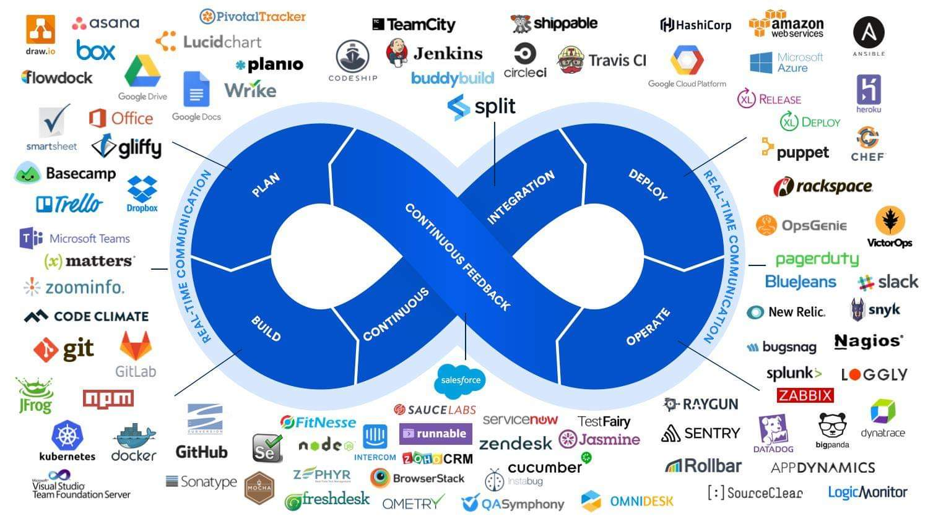
Notes:
SCM : Git ,svn , TFS ,Perforce
Build & Packaging : Maven ,ANT, Gradle
CI : Jenkins ,Bamboo ,Hudson , Solano CI , Circle CI , Teamcity
Testing : Junit ,Selenium ,TestNG
Container: Docker ,Rkt
CM : puppet, Chef, Ansible ,salt stack
Monitoring : Splunk ,ELK,Nagois .

Slide 24
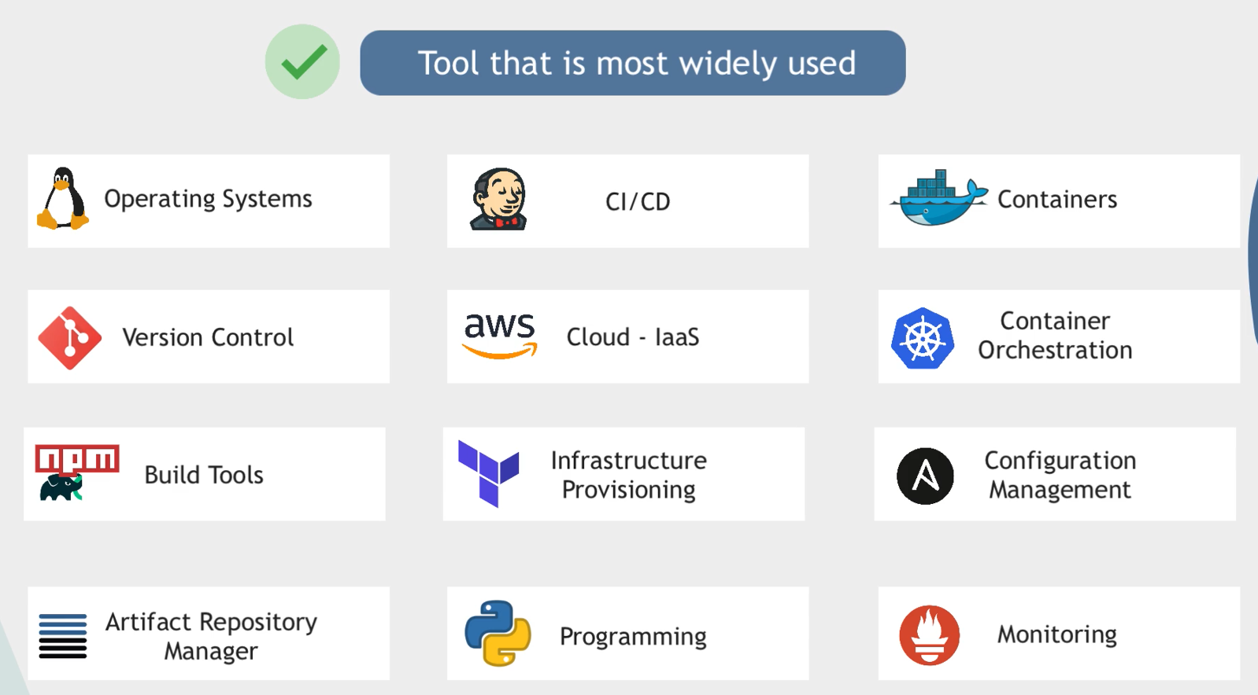
Notes:
Since you are learning the underlying concepts of each tool it will be very easy to understand similar tools.
DevOps gives a shorter development lifecycle.
DevOps is a bottom-up approach.
Not just a set of tools or products.
Different teams implement DevOps in different ways.

Slide 25
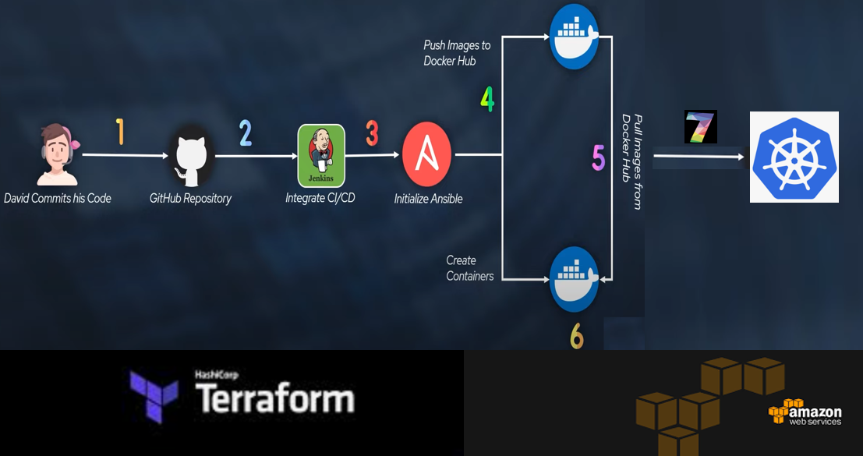













Slide 26

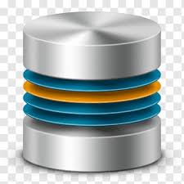
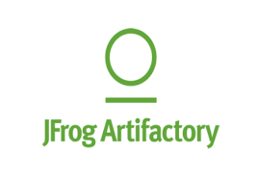
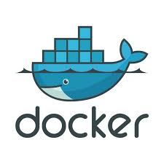




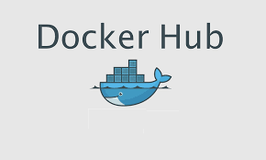






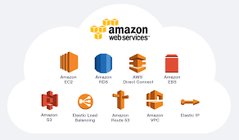

D
E
V
E
L
O
P
E
R
S

Slide 27
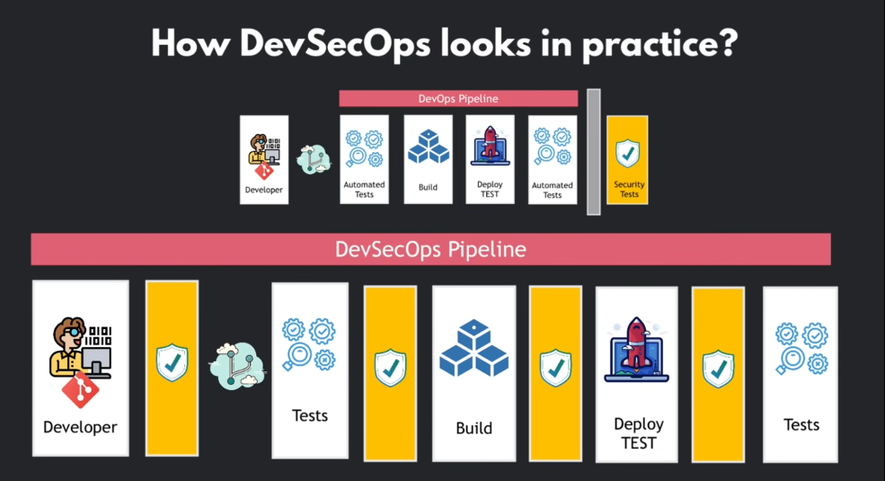

Slide 28
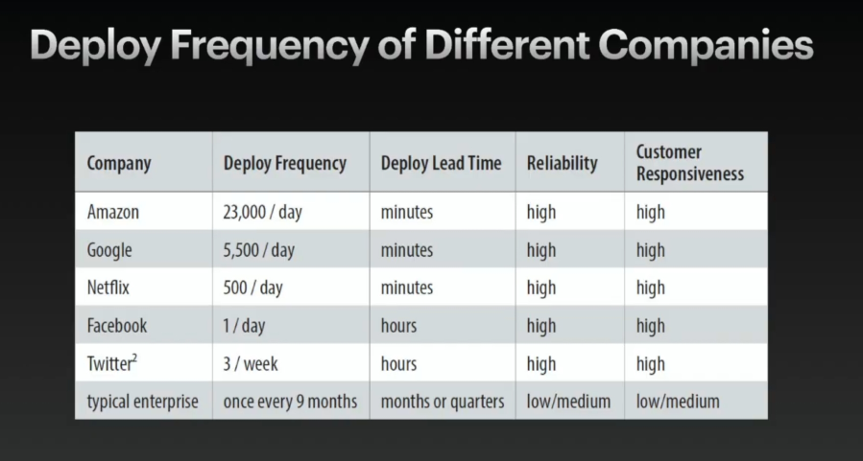

Slide 29
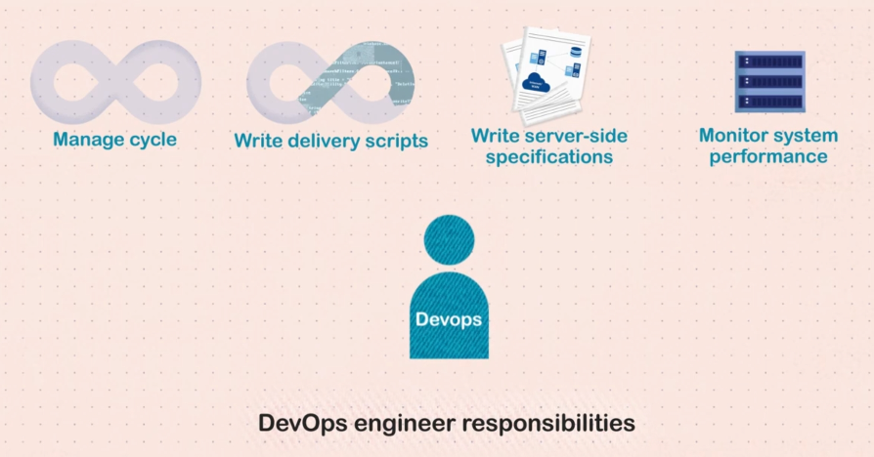

Slide 30
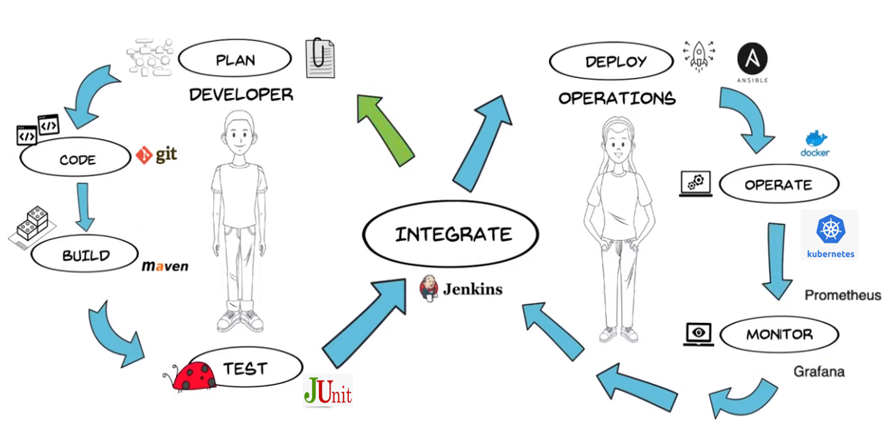

Notes:
Benefit from Devops:
=============
Less time to market
Higher Quality
Less spending
Reduced outage

Slide 31
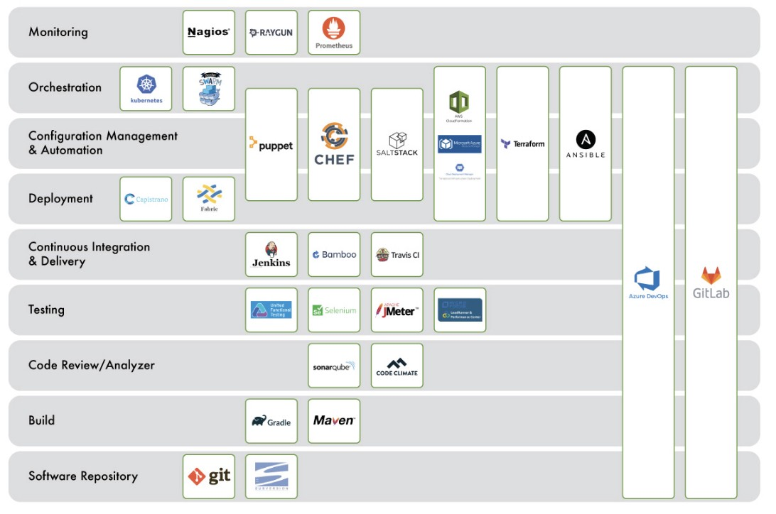

Slide 32
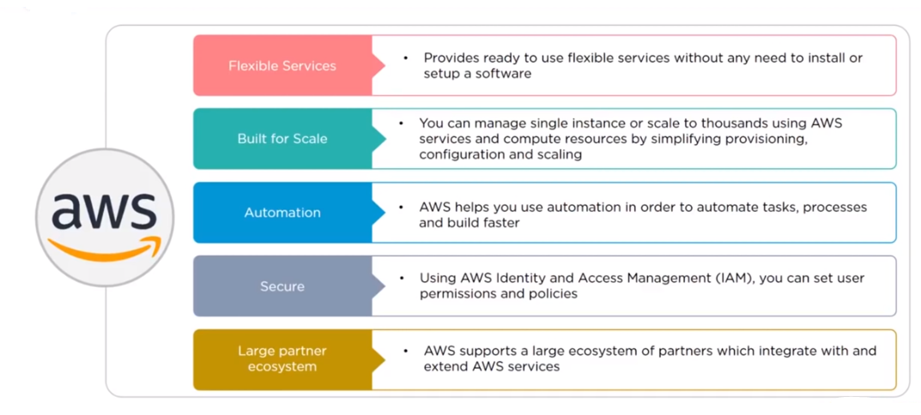

Slide 33
Amazon Web Services
VIKAS
Notes:
What do you need to connect to a webserver ?

Slide 34
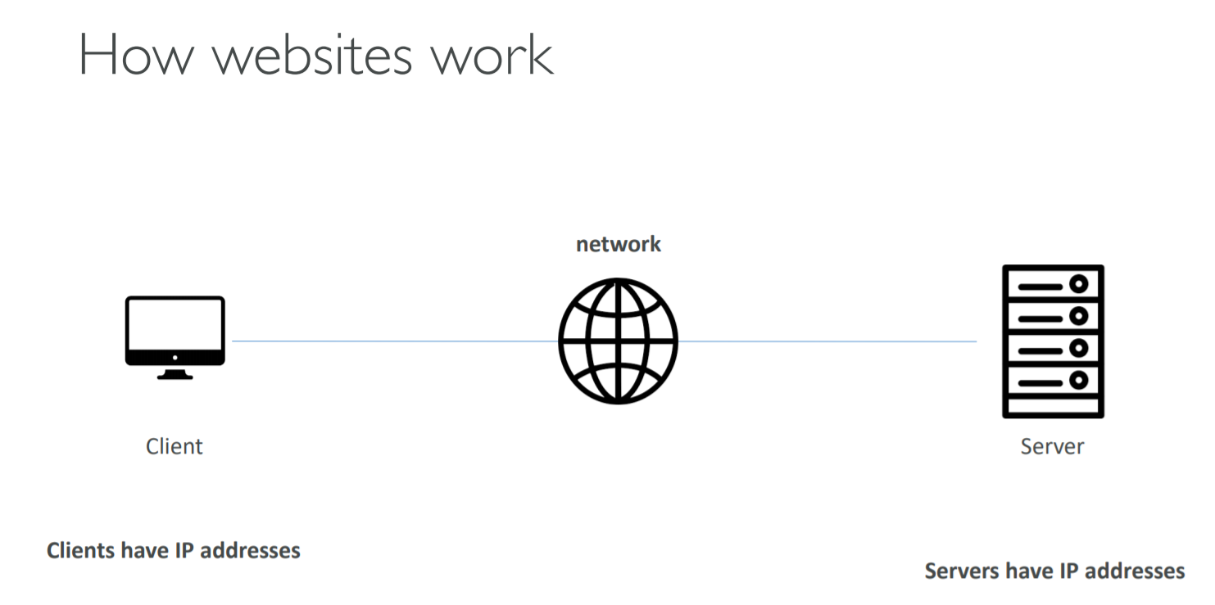
Notes:
Learning is not a race take your time .Add knowledge day by day .Key learning technique is do it yourself .
I have been guiding friends ,colleagues & students on AWS from last five years .I am 5 times certified from AWS so far and counting .Believe me you are with safe hands, so you have made a great choice .

Slide 35
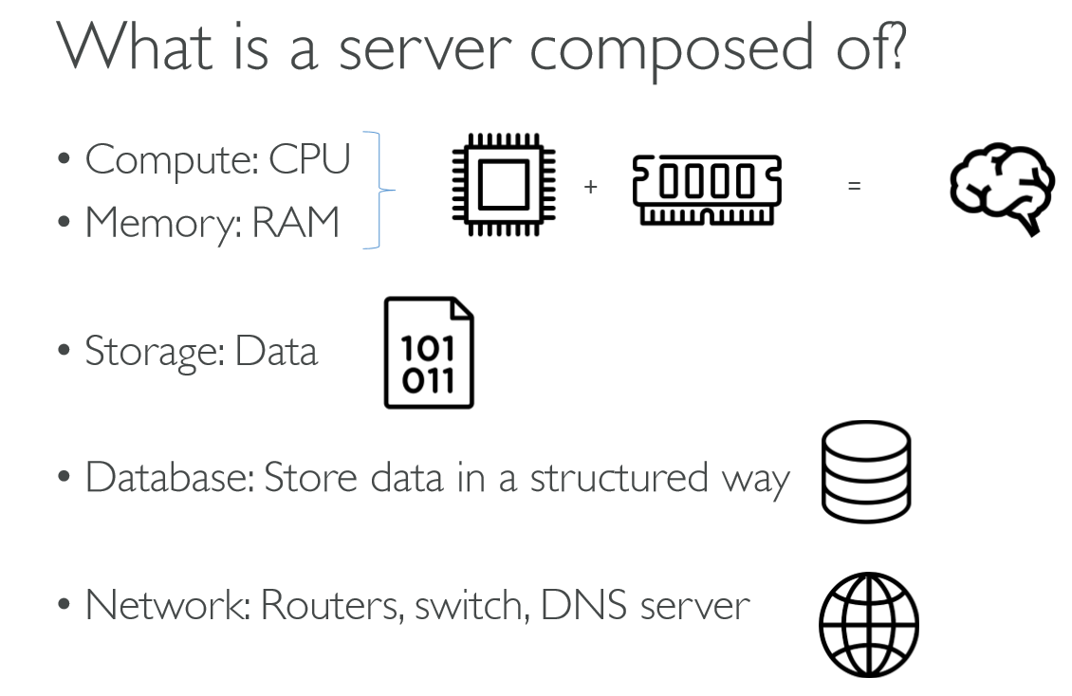
Notes:
Problems with traditional IT approach
Pay for the rent for the data center
Pay for power supply, cooling, maintenance
Adding and replacing hardware takes time
Scaling is limited
Hire 24/7 team to monitor the infrastructure
How to deal with disasters? (earthquake, power shutdown, fire…)

Slide 36
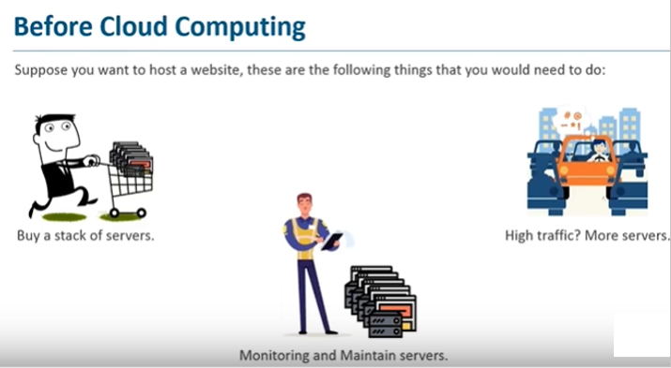
Notes:
Entry level barrier - Before Cloud Computing
--------------------------------------------------
Buy stack of costly servers. If you are considering a business setup cost will be high .
Network traffic – It’s not uniform so your servers are idle for most time (No scaling ) .
Monitoring and server management – Hire more workforce or loose productivity .
Amount of data which is being generated then and now as everything is going online .Now we have tremendous amount of digital data .

Slide 37
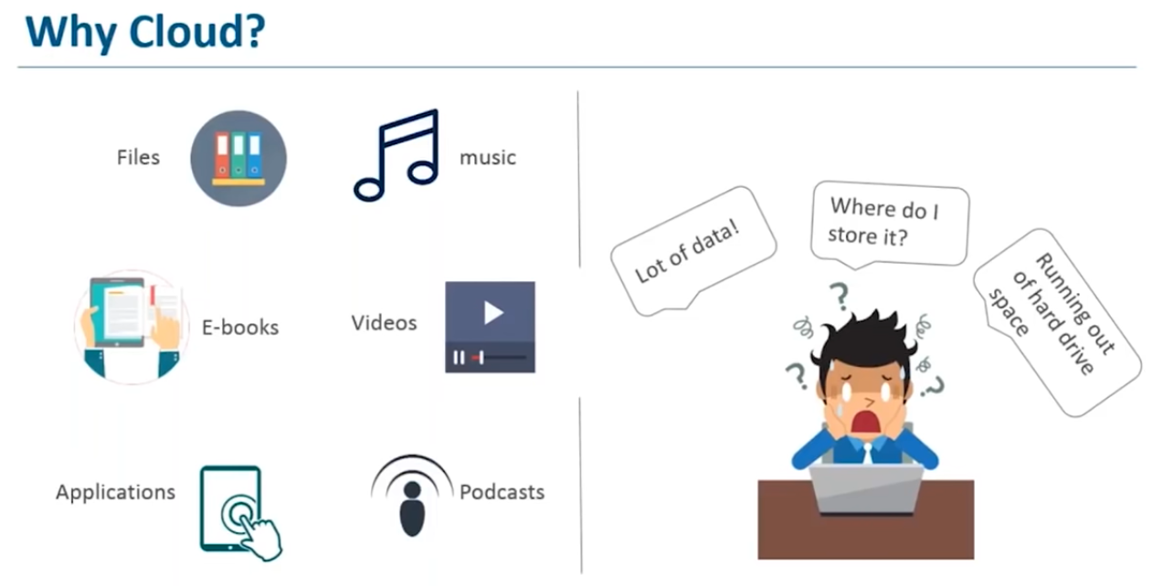
Notes:
Cloud Computing Advantages:
====================
Trade Capital Expense for Variable Expense - Consumption Based Pricing
Benefit from Massive Economies of Scale
Stop Guessing about Capacity
Increase Speed and Agility
Stop spending money running and maintaining data centers
Go Global in Minutes
Need a lot of storage to tackle different data types .

Slide 38
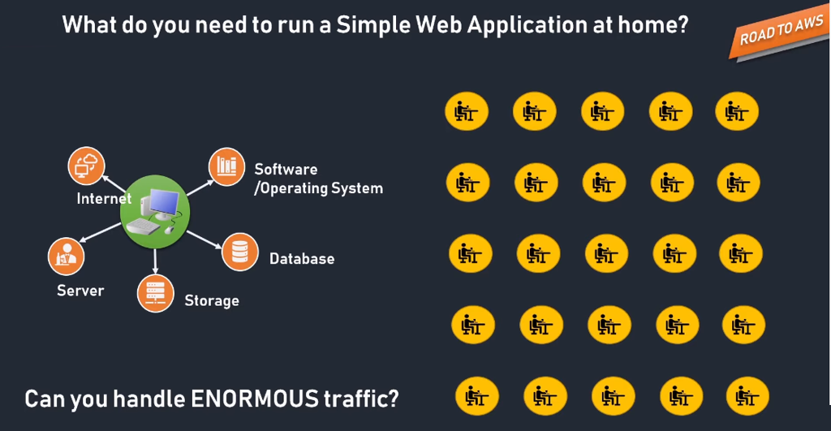
Notes:
Benefits :
Cost
Scalability
Performance
Security
Speed
Productivity
Reliability

Slide 39
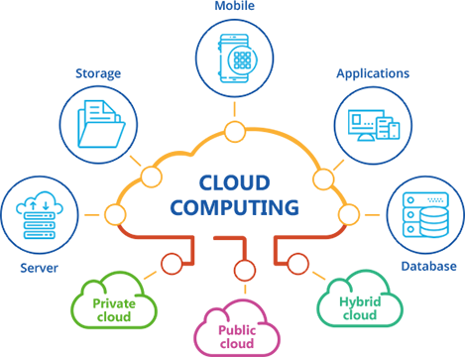
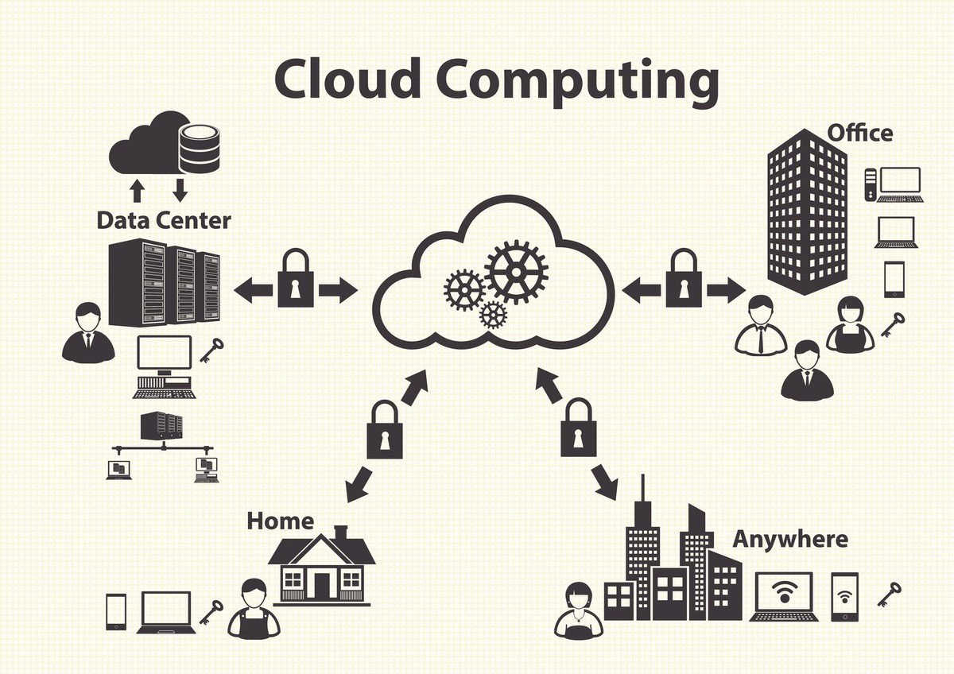
Storing data/application on remote servers.
Processing data/application from servers.
Accessing data/application via Internet
Delivery of on demand computing service over the internet on pay as you go basis .
Notes:
What is Cloud Computing?
------------------------------
Cloud can be termed as collection of huge data centers which are connected by high-speed internet and optical fiber wires all across the globe .So now you rent services and pay as per you go and cloud provider will take care of all headaches .
Cloud computing is a term referred to storing and accessing data over the internet. It doesn't store any data on the hard disk of your personal computer. In cloud computing, you can access data from a remote server.
They will give you unlimited space , manage servers ,network and security for you so that you can concentrate on your business .

Slide 40
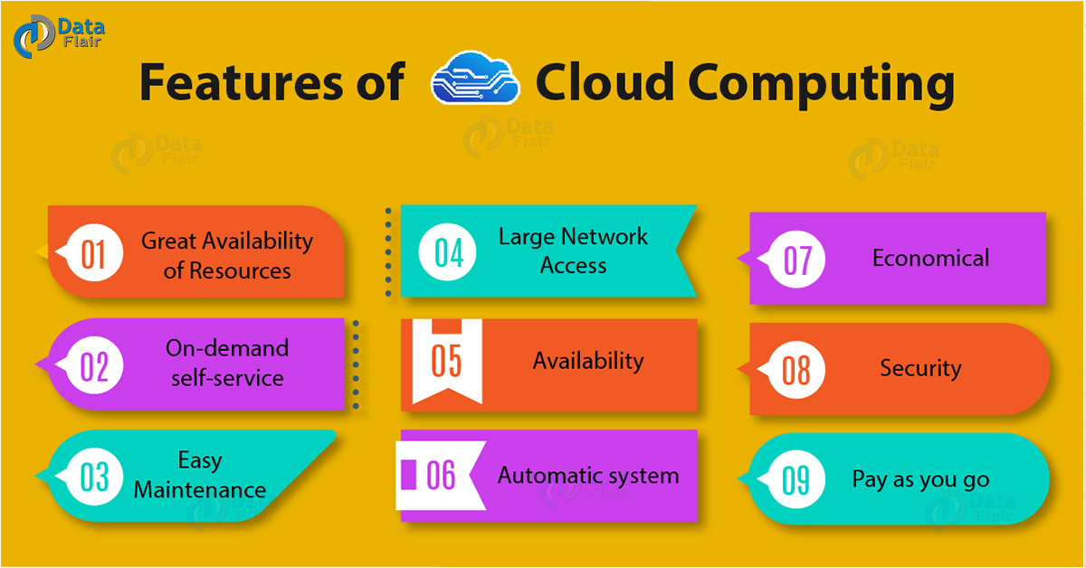
Notes:
Use cases of cloud Implementation :
Create cloud native application.
Store backup and recover data.
Stream Audio and video.
Deliver software on demand
Test and build applications.
Data Analysis and Machine learning .

Slide 41
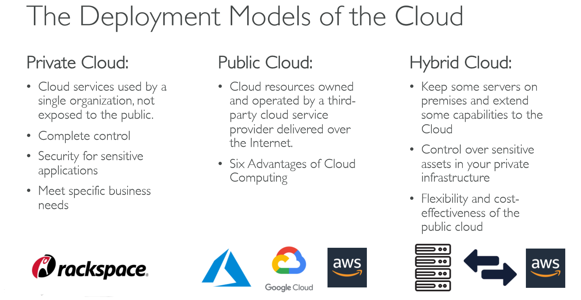
Notes:
AWS is 6 times larger compute capacity than others combined .
Cheap as compared to others (Called poor man’s cloud ).
Lifecycle of cloud computing service :
=========================
Define the purpose
Define the hardware requirement
Define the storage
Define the network
Define security
Define management process and tools .[Cloud watch + cloud formation + auto scaling ]
Testing the process [code start + code build + code pipeline ] .
Analytics [Athena + EMR + Cloud search ] .

Slide 42
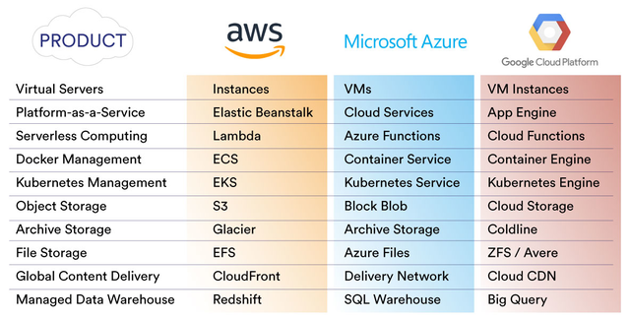

Slide 43
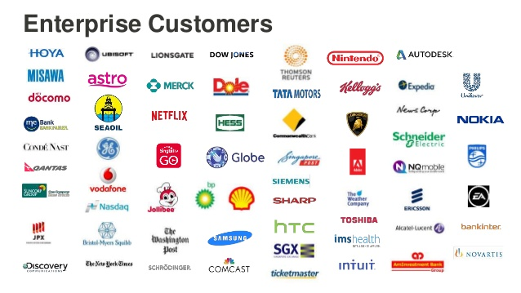

Slide 44
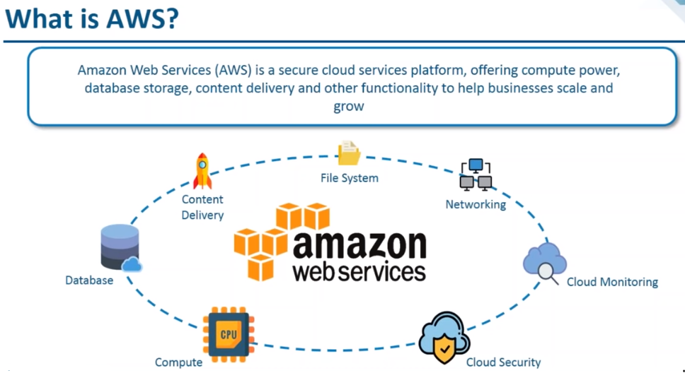
Notes:
AWS is a comprehensive, easy to use computing platform offered by Amazon. AWS is secure cloud service platform , offering compute power ,database storage ,content delivery and other functionalities to help business scale & grow .
#!/bin/bash
yum update -y
yum install -y httpd
systemctl start httpd
systemctl enable httpd
echo “<h1>Hello World from $(hostname -f)</h1>” > /var/www/html/index.html

Slide 45
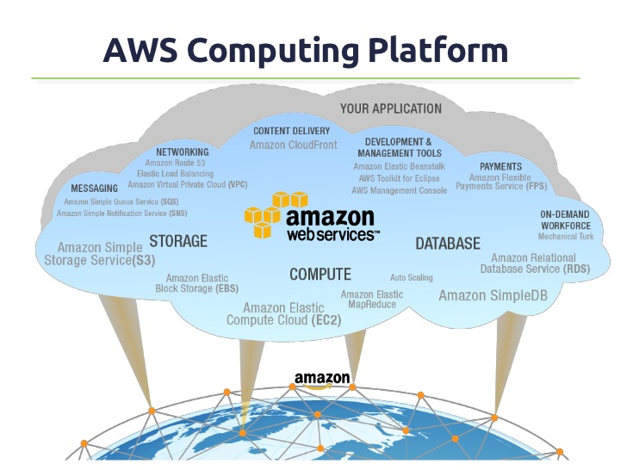

Slide 46
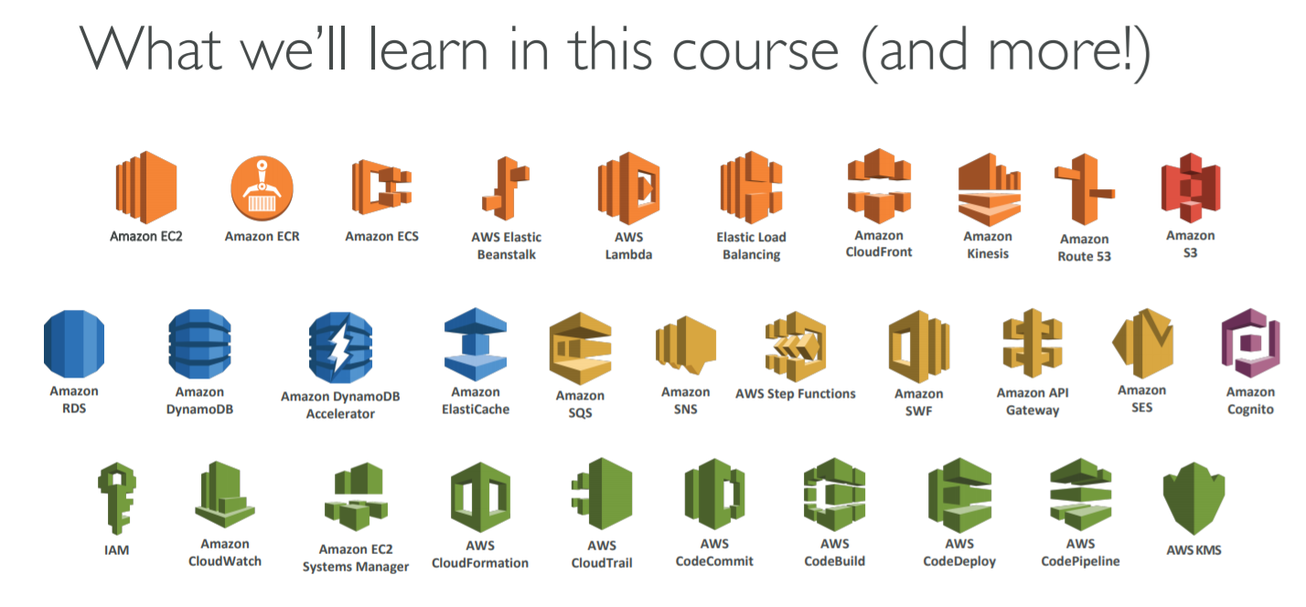
Notes:
We cover 30 + service
Try try try till you understand .
Practice daily and don’t hesitate to ask questions if you have doubt .
Create a free AWS account .
Ready to rock !! Happy learning !!

Slide 47
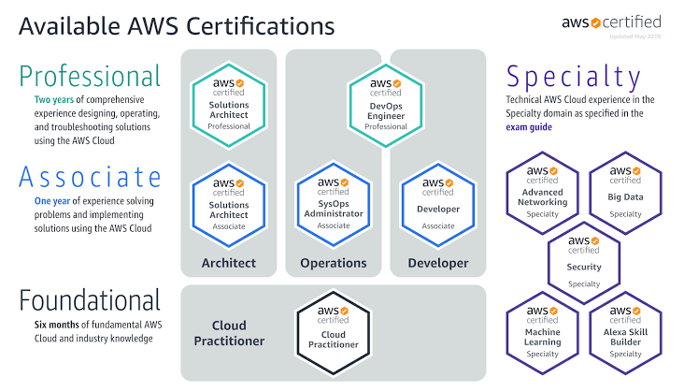

Slide 48
Questions ????

Slide 49
